Slide 1

G2M Case Study
Virtual Internship
28-April-2022

Slide 2
Background –G2M(cab industry) case study
XYZ is a private equity firm in US. Due to remarkable growth in the Cab Industry in last few years and multiple key players in the market, it is planning for an investment in Cab industry.
Objective : Provide actionable insights to help XYZ firm in identifying the right company for making investment.
The analysis has been divided into four parts:
Data Understanding
Data Cleaning
Exploratory Data Analysis

Slide 3
Data Understanding
Given with 4 datasets:
Cab_Data.csv :
This file includes details of transaction for 2 cab companies.
Customer_ID.csv :
This is a mapping table that contains a unique identifier which links the customer’s demographic details.
Transaction_ID.csv :
This is a mapping table that contains transaction to customer mapping and payment mode.
City.csv :
This file contains list of US cities, their population and number of cab users

Slide 4
Data Cleaning
The following steps where taken to clean the data:
Check for null values
Check for duplicate entries
Check names of columns
Check datatype and values in columns
Check unique values in columns
Merge dataframes and drop columns not necessary for analysis
Derive features, if necessary
Check for outliers
Sanity checks

Slide 5
Exploratory Data Analysis
The following where done to explore the data:
Univariate analysis
Bivariate analysis
Multivariate analysis

Slide 6
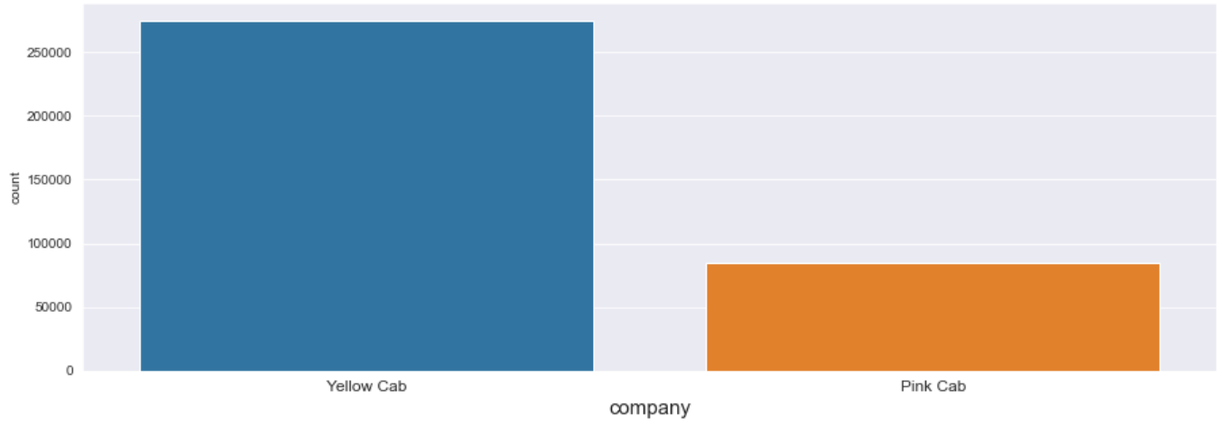
Exploratory Data Analysis
There is more data pertaining to yellow cab

Slide 7
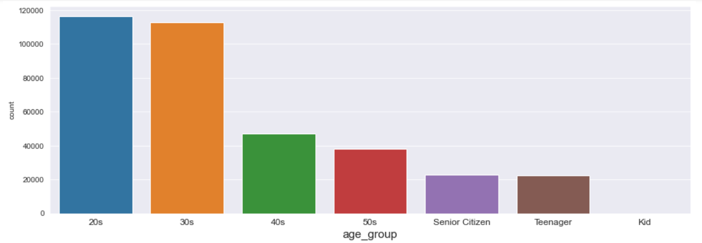
Exploratory Data Analysis
Most no of cab users fall in the age groups of 20-40

Slide 8
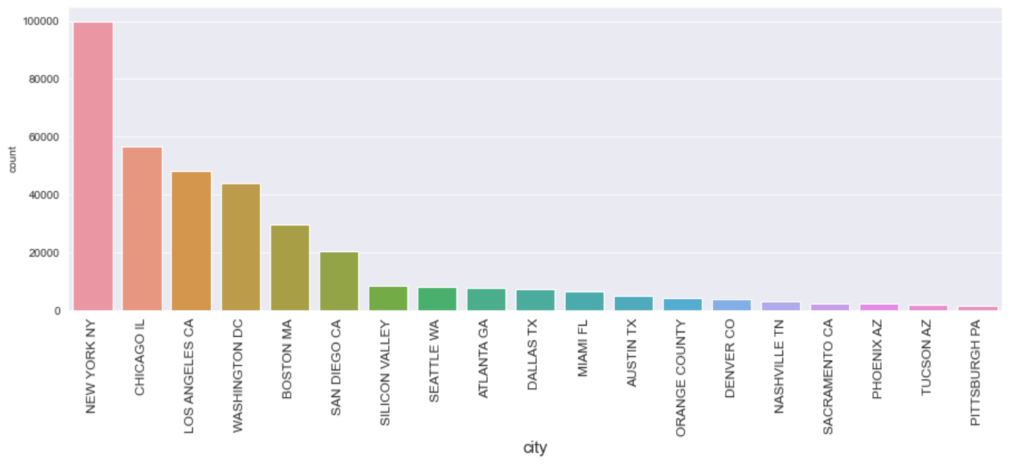
Exploratory Data Analysis
More no of cab users are from Newyork (almost double the no of the runner city), followed by Chicago, WashingtonDC and Ls Angeles

Slide 9
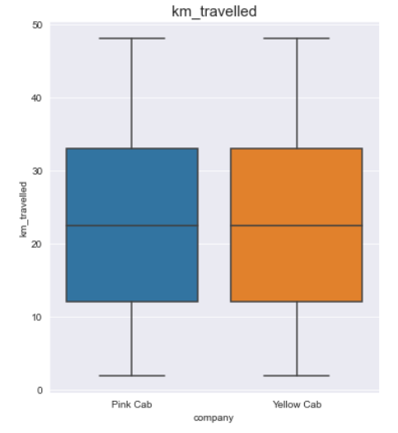
Exploratory Data Analysis
The km_travelled is comparable for both Yellow and Pink cab

Slide 10
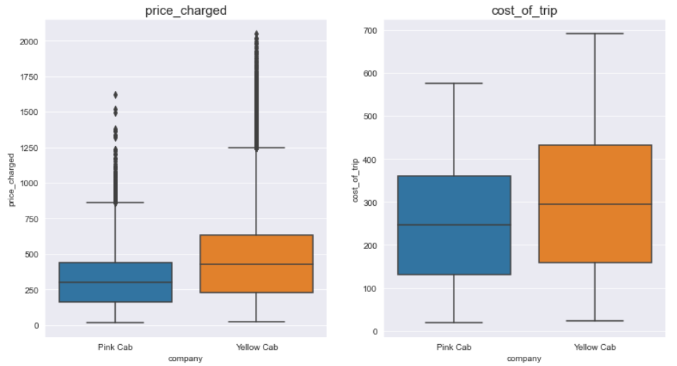
Exploratory Data Analysis
Both price_charged and cost_of_trip is comparatively higher for Yellow cab than Pink cab

Slide 11
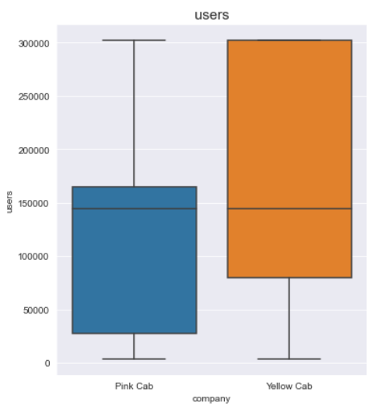
Exploratory Data Analysis
In all the cities where the no of users is high, more no of poeple have opted for Yellow cab, especially in Neywork where this amount is almost 4 times that for Pink cab

Slide 12
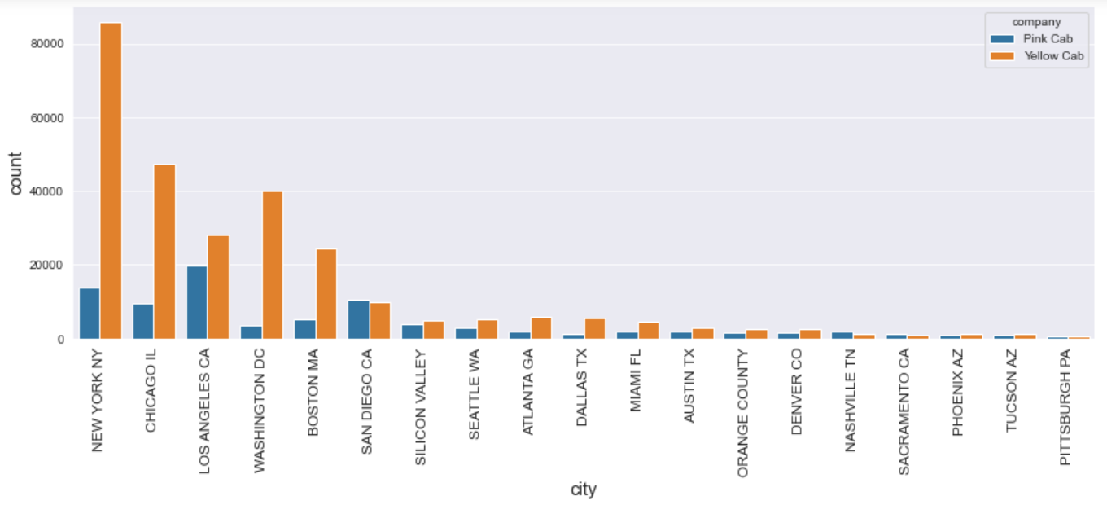
Exploratory Data Analysis

Slide 13
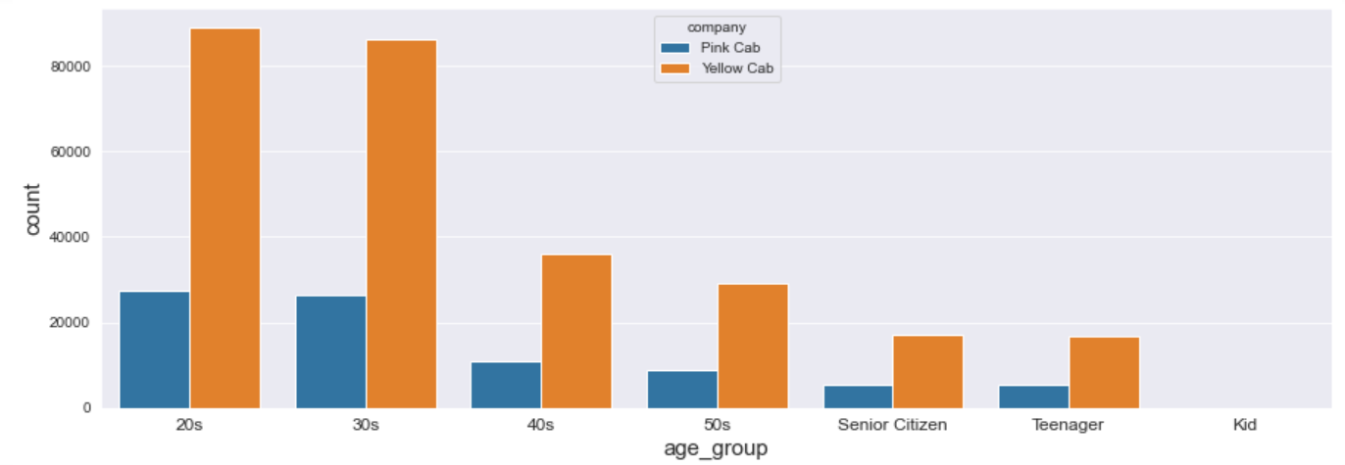
Exploratory Data Analysis
All age groups have shown more interest in Yellow cab than pink cab

Slide 14
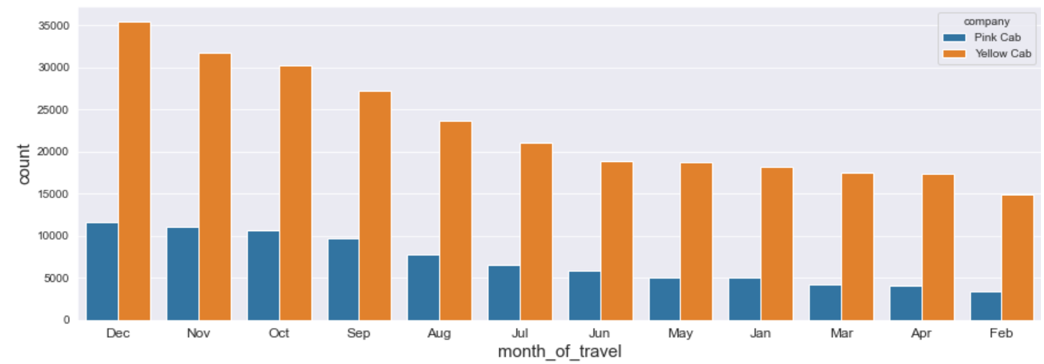
Exploratory Data Analysis
There is more demand for cabs (here also Yellow cab is in favour) during the last months of the year (highest in december) and low during the first months of the year (lowest in february).

Slide 15
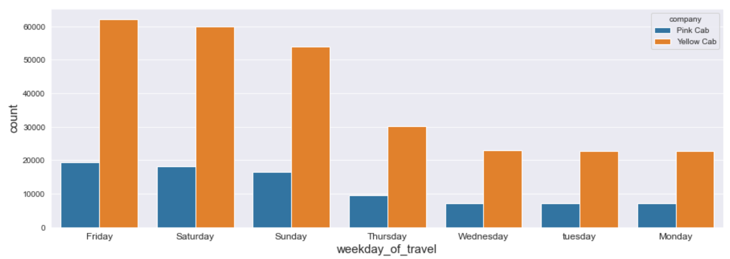
Exploratory Data Analysis
More people have been found to using cab on Fridays, Saturdays and Sundays .i.e., when the weekend starts and during the weekend.

Slide 16
Recommendations
It is best to invest in Yellow Cab.
The reasons for the same are:
More income per month
More users
Comparatively higher cost of trip and price charged, but not too high for users to look in for alternatives.

Slide 17
Thank You

